Slide 1

COVID-19 World Vaccination Progress

Slide 2
Introduction
Besides what we have known since the end of 2020, the World Health Organization (WHO) start introducing the COVID-19 vaccine toolkit equips all countries to prepare for and implement COVID-19 vaccination by providing guidance, tools, and training.

Slide 3

Project Aims
The project support Ministries of Health, health workers, partner organizations, and other stakeholders.

Slide 4
Table of Contents
01
02
03
04
Design
Data
Algorithms
Tools
05
Conclusion

Slide 5

01
Design

Slide 6

Design
The project design plan:
Find average of vaccinations for each country.
Find top countries with got vaccinations.
Find total vaccinations in Saudi and visualize it.
Visualize people vaccinated vs people fully vaccinated in
Saudi Arabia.
Use time series analysis forecasting method for predict
total number of vaccinations for the next month.

Slide 7

02
Data

Slide 8
Data
Dataset source:
https://www.kaggle.com/gpreda/covid-world-vaccination-progress?select=country_vaccinations.csv
Description of the Dataset:
This dataset tracks the total number of COVID-19 vaccinations administered in each country, broken down by first and second doses (where national data is available), and derived daily vaccination rates and population-adjusted figures.
The dataset include 61613 records and 15 features.

Slide 9

Algorithms
03

Slide 10
Algorithms – Part1
Firstly, I have done some (EDA) that can be found in the notebook such as delete unnecessary columns and delete null values.
Secondly, In this project I tried to apply time series analysis forecasting method which is AutoRegressive Integrated Moving Average (ARIMA) since I’m dealing with only two columns which are (date, daily vaccinations). - The dataset after (EDA) include 329 records, so I make train for 79% and test on 21% of the data. More likely 8 months for train and 3 months for test.

Slide 11
Algorithms – Part1
According to (ARIMA) model must check if the daily vaccinations all dates stationarity or not? I use Augmented Dickey Fuller test (ADF Test) and the result was -1.8 which means it’s not stationarity. Therefore, we can not apply the model on it.

Slide 12
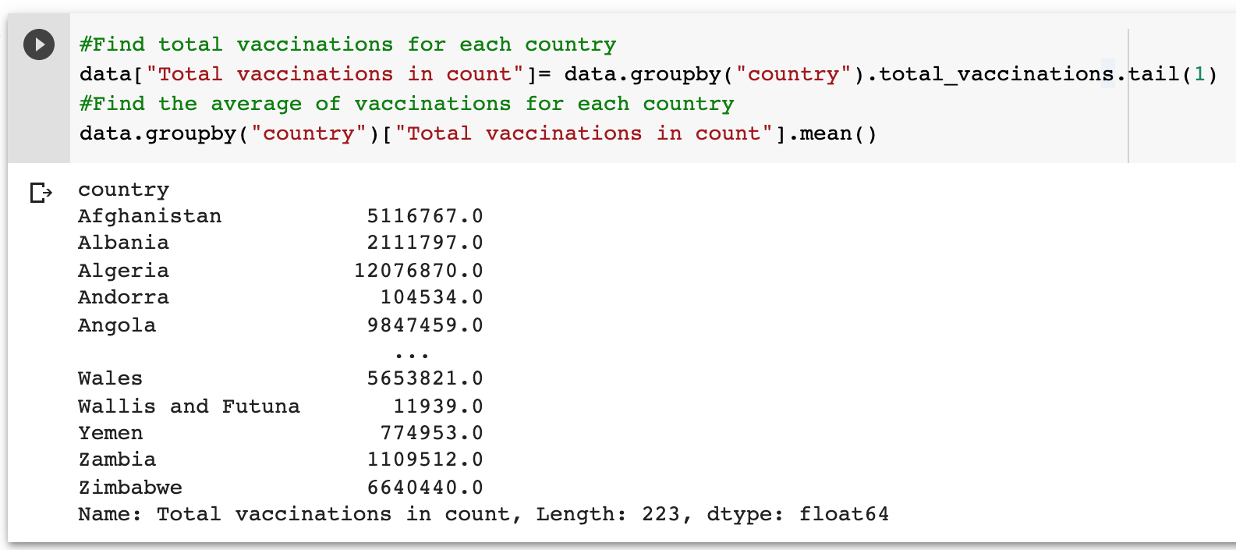
Find average of vaccinations for each country.

Slide 13
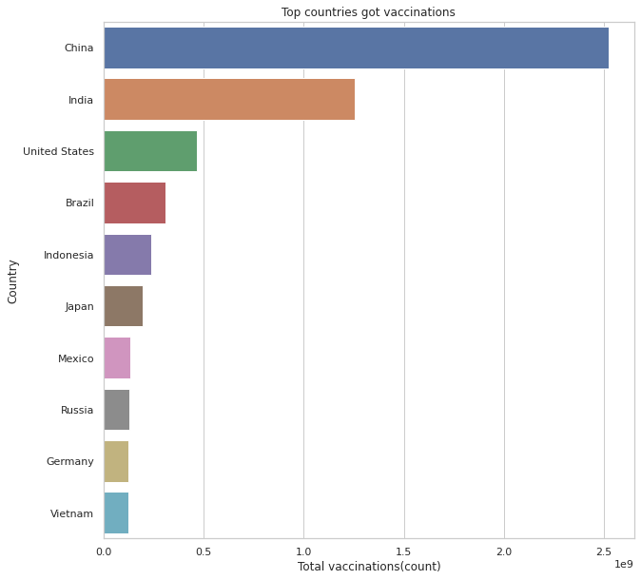
Find top countries with got vaccinations.

Slide 14
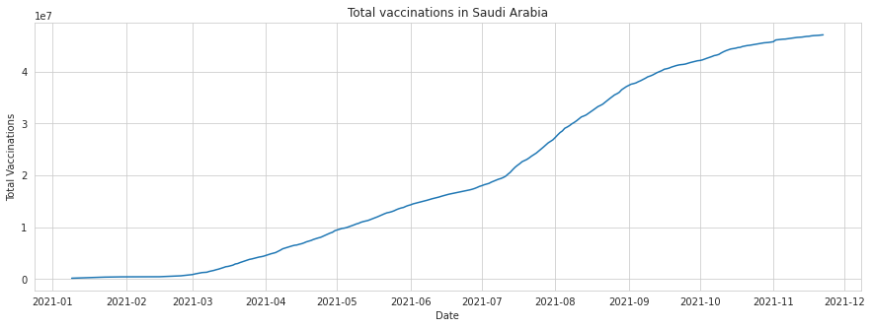
Find total vaccinations in Saudi and visualize it.

Slide 15
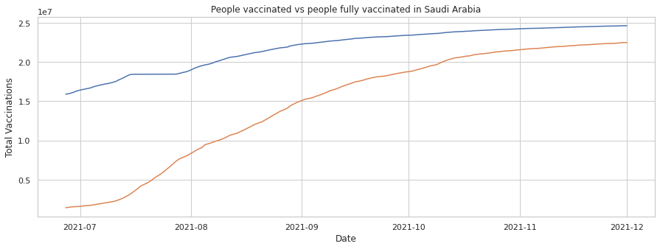
Visualize people vaccinated vs people fully vaccinated in
Saudi Arabia.

Slide 16
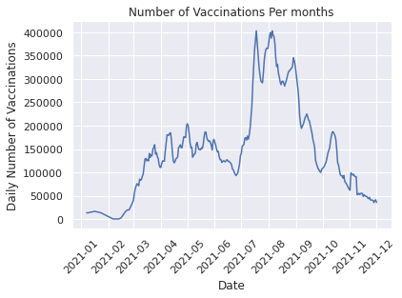
Use time series analysis forecasting method for predict
total number of vaccinations for the next month.
First plot Number of Vaccinations Per months

Slide 17
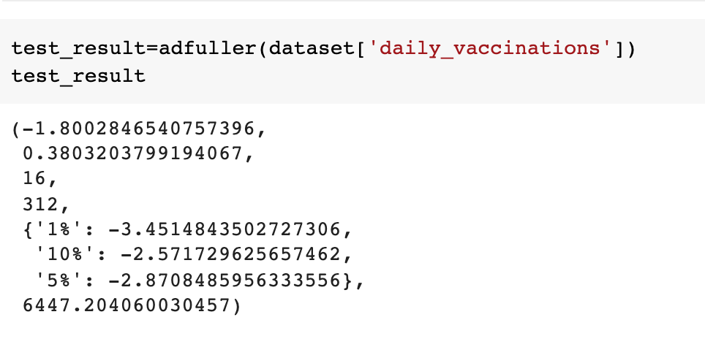
As we can see the data is not stationarity, but we check it by using Augmented Dickey Fuller test (ADF Test) and the result is not stationarity.
Augmented Dickey Fuller test (ADF Test) result was -1.8 which means it’s not stationarity. Therefore, we can not apply the model on it.

Slide 18

Tools
04

Slide 19
Tools
Data processing
Modeling
Visualization
numpy and pandas for data manipulation.
ARIMA for modeling.
matplotlib and seaborn for plotting.
Environment
Google colab.

Slide 20
Conclusion
Daily vaccinations is not consistent over time. Therefore, it's very unpredictable.

Slide 21

Thank You for listening!

